Slide 1

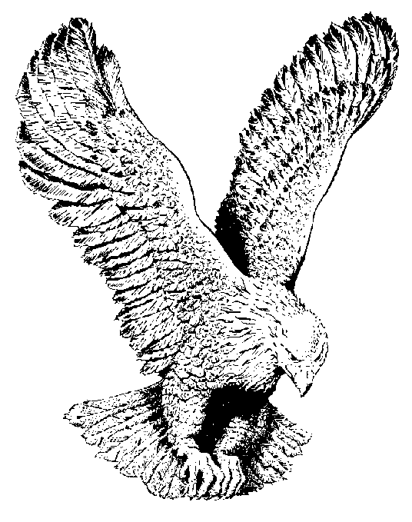
VICTORY
Victory, victory,
Over all the powers of darkness, victory;
When the battle’s in array,
Angels help us in the fray;
And God fights for those who pray, victory.

